Slide 1
Channel polarization:
A method for constructing capacity-achieving codes for symmetric binary-input memoryless channels
Erdal Arıkan (IEEE Transactions on Information Theory, 2009)

Slide 2
Introduction and Overview
What are we solving?
Reliable communication over noisy channels is the goal of coding theory.
Shannon’s theorem: We can transmit data up to the channel capacity C with arbitrarily low error.
Challenge: Construct codes that achieve C practically and provably.
What are polar codes?
Error correcting codes designed using the idea of channel polarization.
Efficient encoding and decoding algorithms (complexity O(Nlog⁡N)).
Key innovation: Channel Polarization.
Main Idea:
Transform N copies of a channel into polarized versions: some become very good, others very bad.
Send important data over good channels and ignore bad channels.

Slide 3
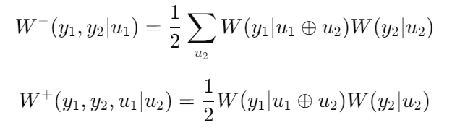
Recursive Channel Transformations (Section II)
Key Idea:
Use a recursive combination of channels to achieve polarization.
Two channels are combined into a “better” and a “worse” channel.
Transformation:
Given two independent uses of a binary-input channel W, create two new channels:
Interpretation:
W−: More noisy, combining the uncertainties of both channels.
W+: Less noisy, leveraging redundancy.
Recursive Nature:
Repeat this process for N=2^n channels.

Slide 4
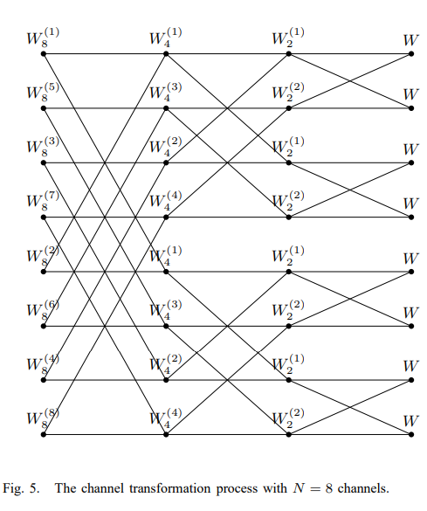
Transformation of Rate and Reliability (Section III)
Rate (Capacity) Transformation:
Total capacity of two combined channels remains constant: I(W−) + I(W+) = 2*I(W)
I(W): Capacity of channel W.
Reliability Transformation:
Good channels become better, bad channels become worse.
Polarization ensures that as N→∞ most channels are either perfect (I(W)→1) or useless (I(W)→0).

Slide 5
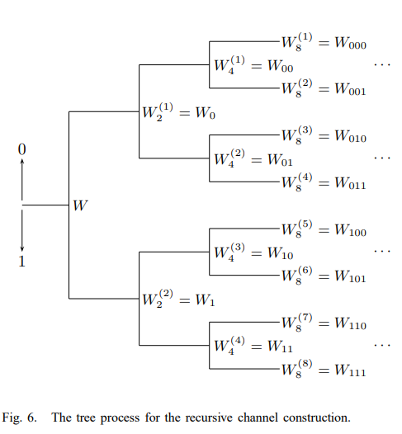
Channel Polarization (Section IV)
Definition:
Channel polarization: Process where N→∞ transforms channels into polarized states (perfect or useless).
Key Result:
Fraction of good channels approaches I(W), the capacity of the original channel.
Mathematical Foundation:
Polarization is formalized using Bhattacharyya parameter Z(W), which measures reliability:
Z(W−) = 2*Z(W) − Z(W)^2,
Z(W+) = Z(W)^2

Slide 6


Performance of Polar Coding (Section V)
Encoding:
Transform input bits using a generator matrix
Decoding:
Successive Cancellation (SC) decoding: Decodes bit-by-bit using probabilities from polarized channels.
Error Performance:
As N→∞, error probability Pe→0 for the good channels.
Key Theorem:
Polar codes achieve capacity: R = k/N →I(W) as N→∞

Slide 7
Symmetric Channels (Section VI)
Symmetric Binary-Input Memoryless Channels (B-DMCs):
A channel is symmetric if its behavior is identical for both input symbols (0 and 1).
Examples: Binary Symmetric Channel (BSC), Binary Erasure Channel (BEC).
Why Symmetric Channels?
Polar codes were designed for these channels, simplifying analysis and achieving Shannon capacity.
Special Case - BEC:
Polarization is easier to visualize and analyze: Z(W−) = Z(W)^2, Z(W+) = 2*Z(W) − Z(W)^2

Slide 8
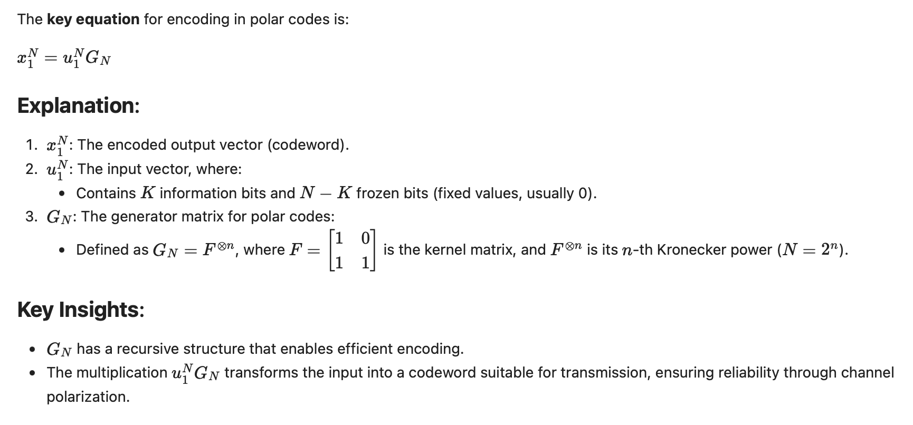
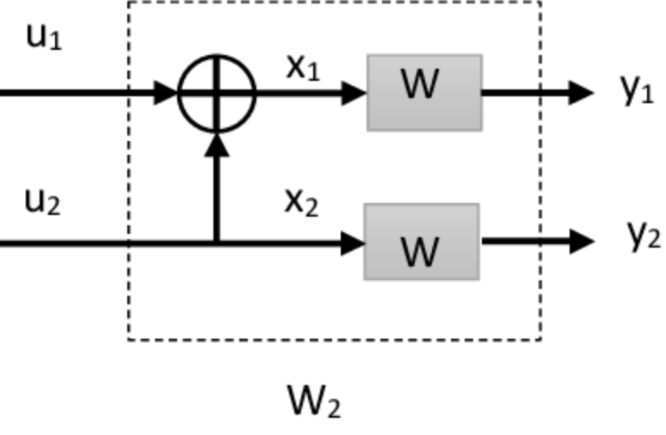
Encoding (Section VII)
Details the practical implementation of polar code encoding.

Slide 9
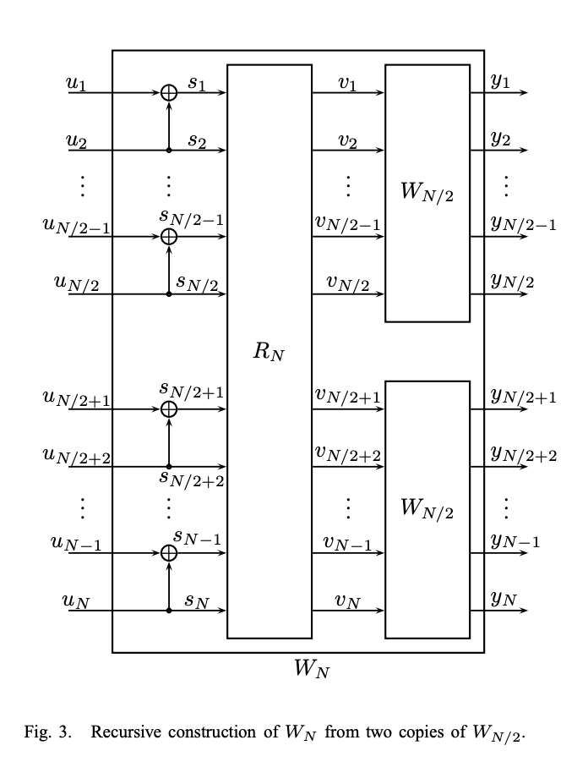
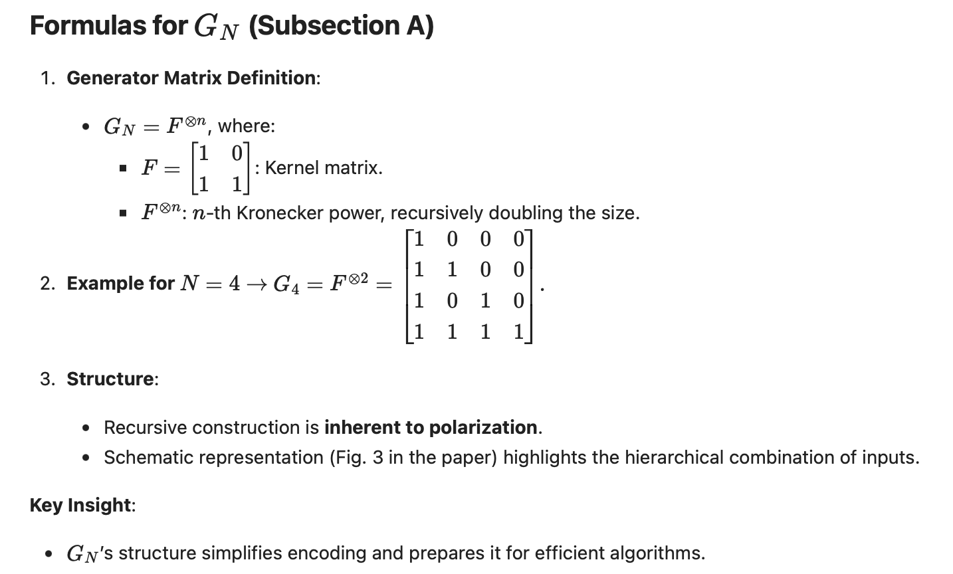
Encoding (Section VII)
Details the practical implementation of polar code encoding.
5G -> N=128,256,and 512.

Slide 10
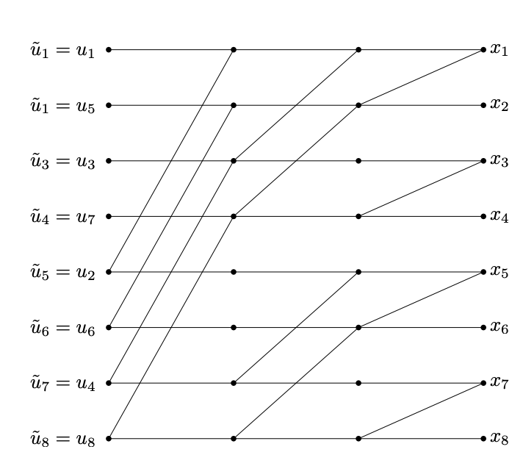
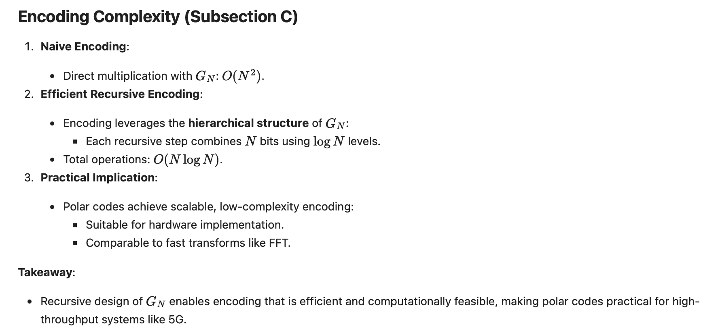
Encoding (Section VII)
Details the practical implementation of polar code encoding.
butterfly structure of polar code encoding
illustrates the hierarchical recursive operations

Slide 11
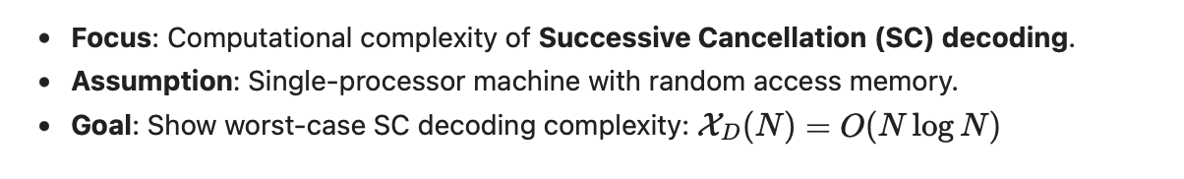
Successive Cancellation Decoding (Section VII)
Describes the successive cancellation decoding algorithm for polar codes.
Provides a complexity analysis of the decoding process.
Explains the relationship between decoding performance and channel polarization.

Slide 12
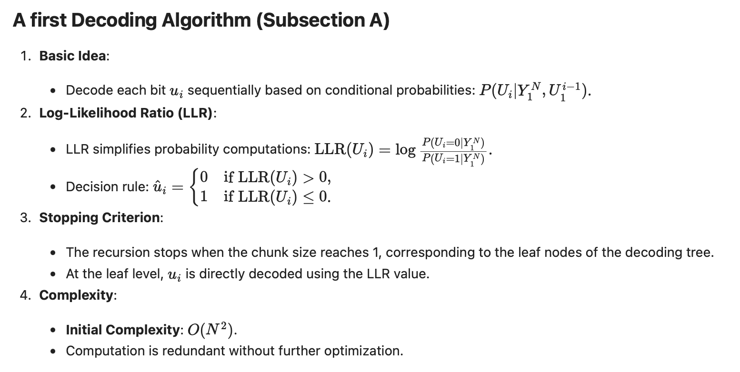
Successive Cancellation Decoding (Section VII)

Slide 13
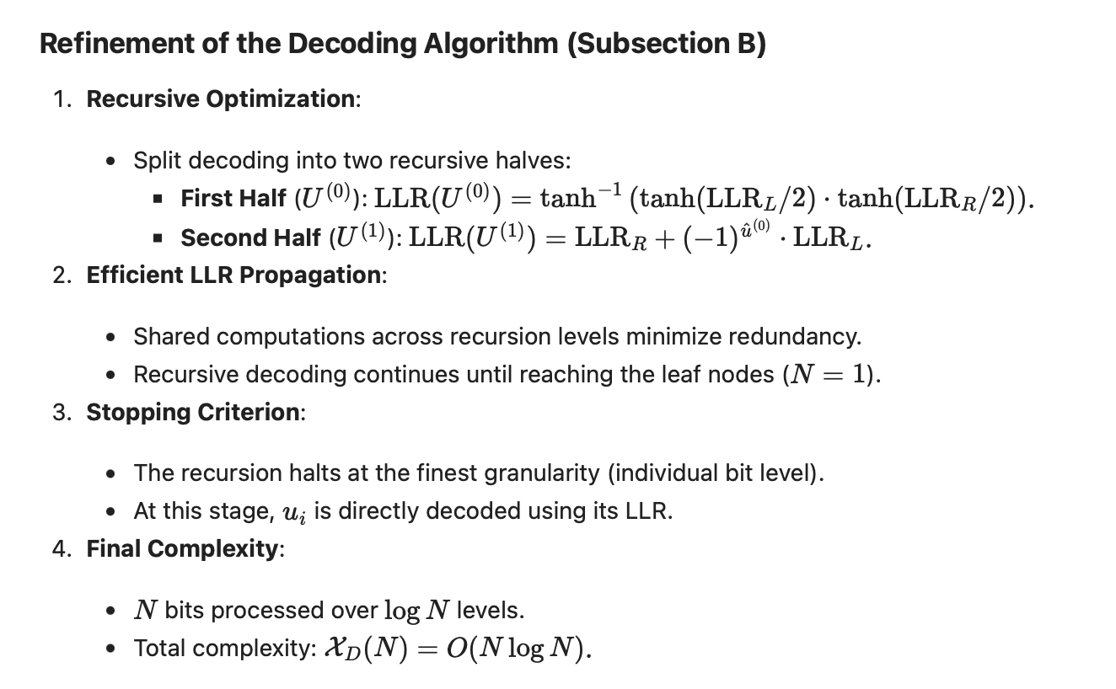
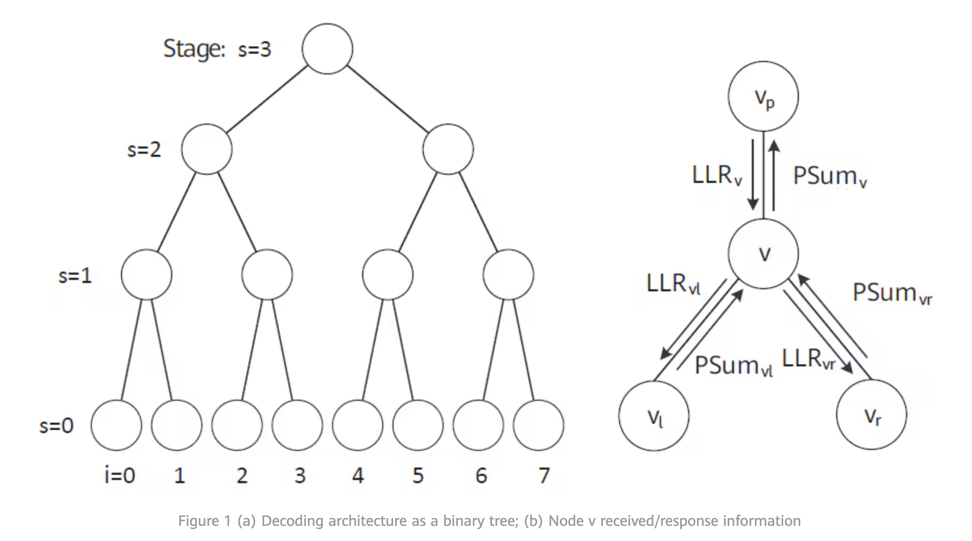
Successive Cancellation Decoding (Section VII)
By caching and reusing intermediate LLR values, redundant computations are eliminated.
LLR measures the relative likelihood of a bit being 0 or 1
tanh-based compression ensures that the values are normalized

Slide 14
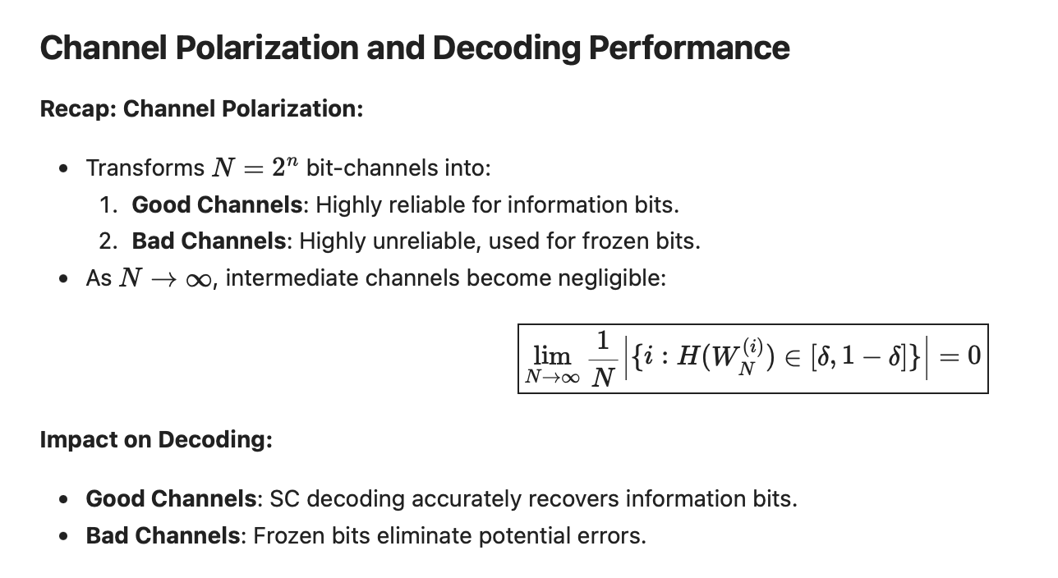
Successive Cancellation Decoding (Section VII)
Explains the relationship between decoding performance and channel polarization.

Slide 15
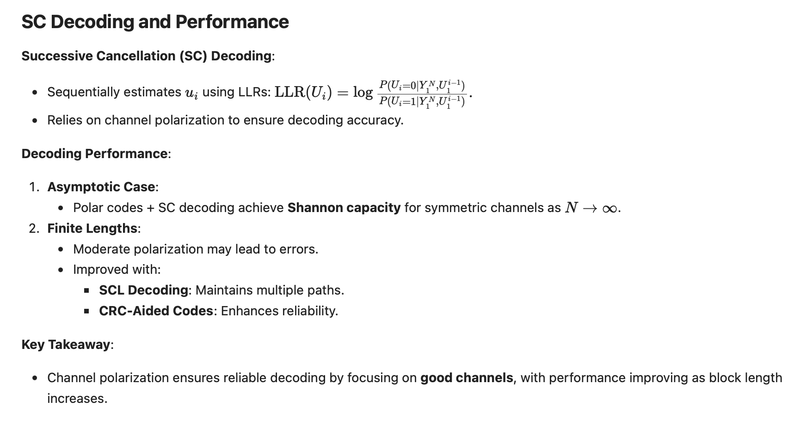
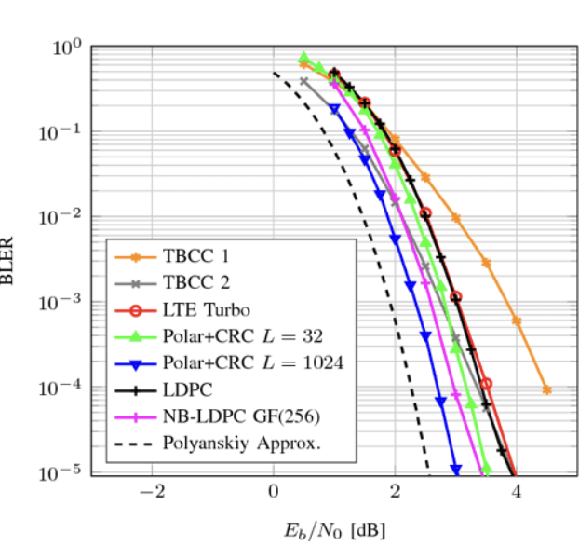
Successive Cancellation Decoding (Section VII)
Explains the relationship between decoding performance and channel polarization.

Slide 16
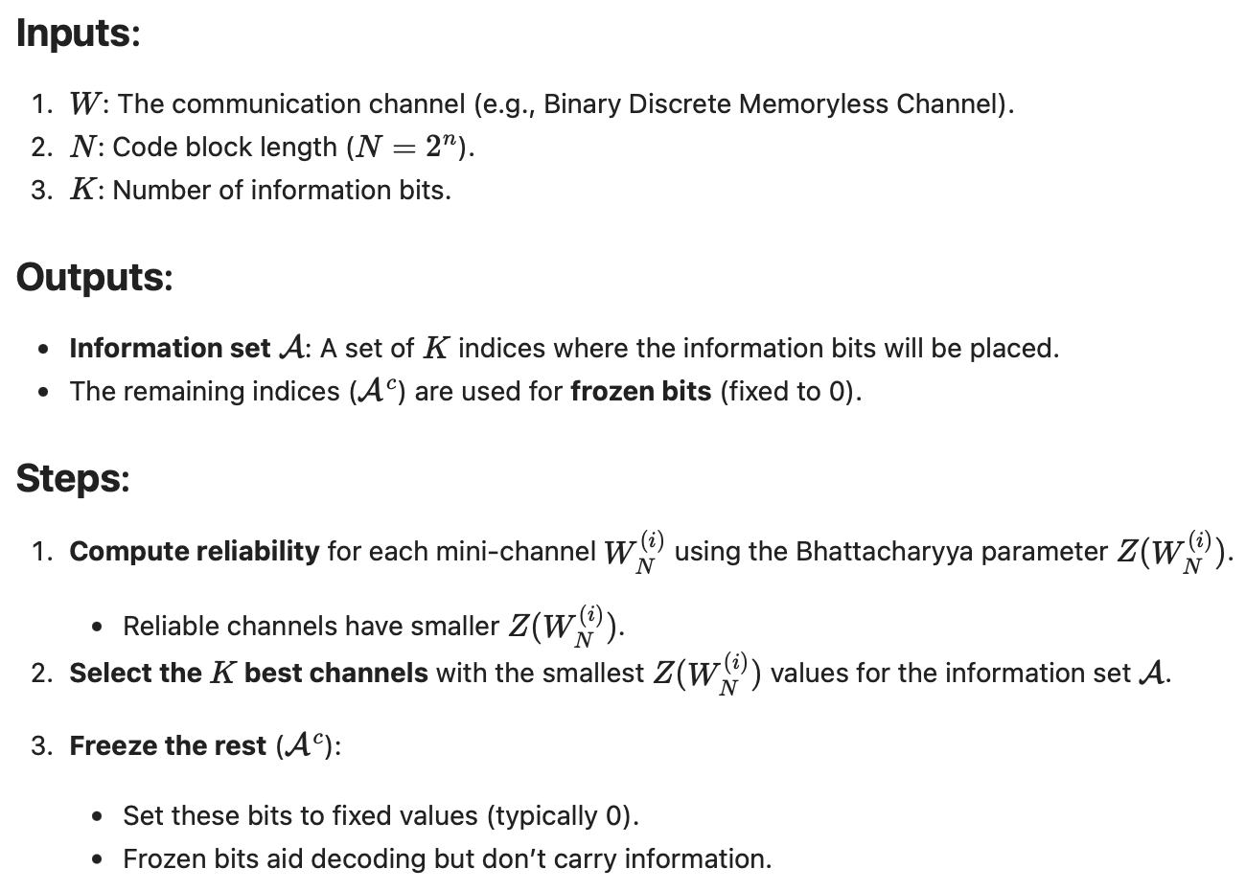
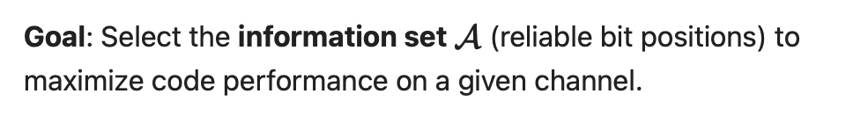
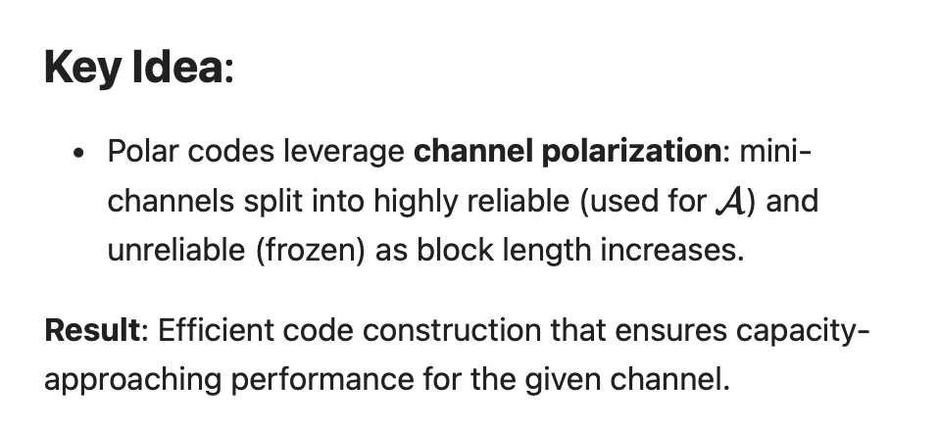
Code Construction (Section IX)

Slide 17
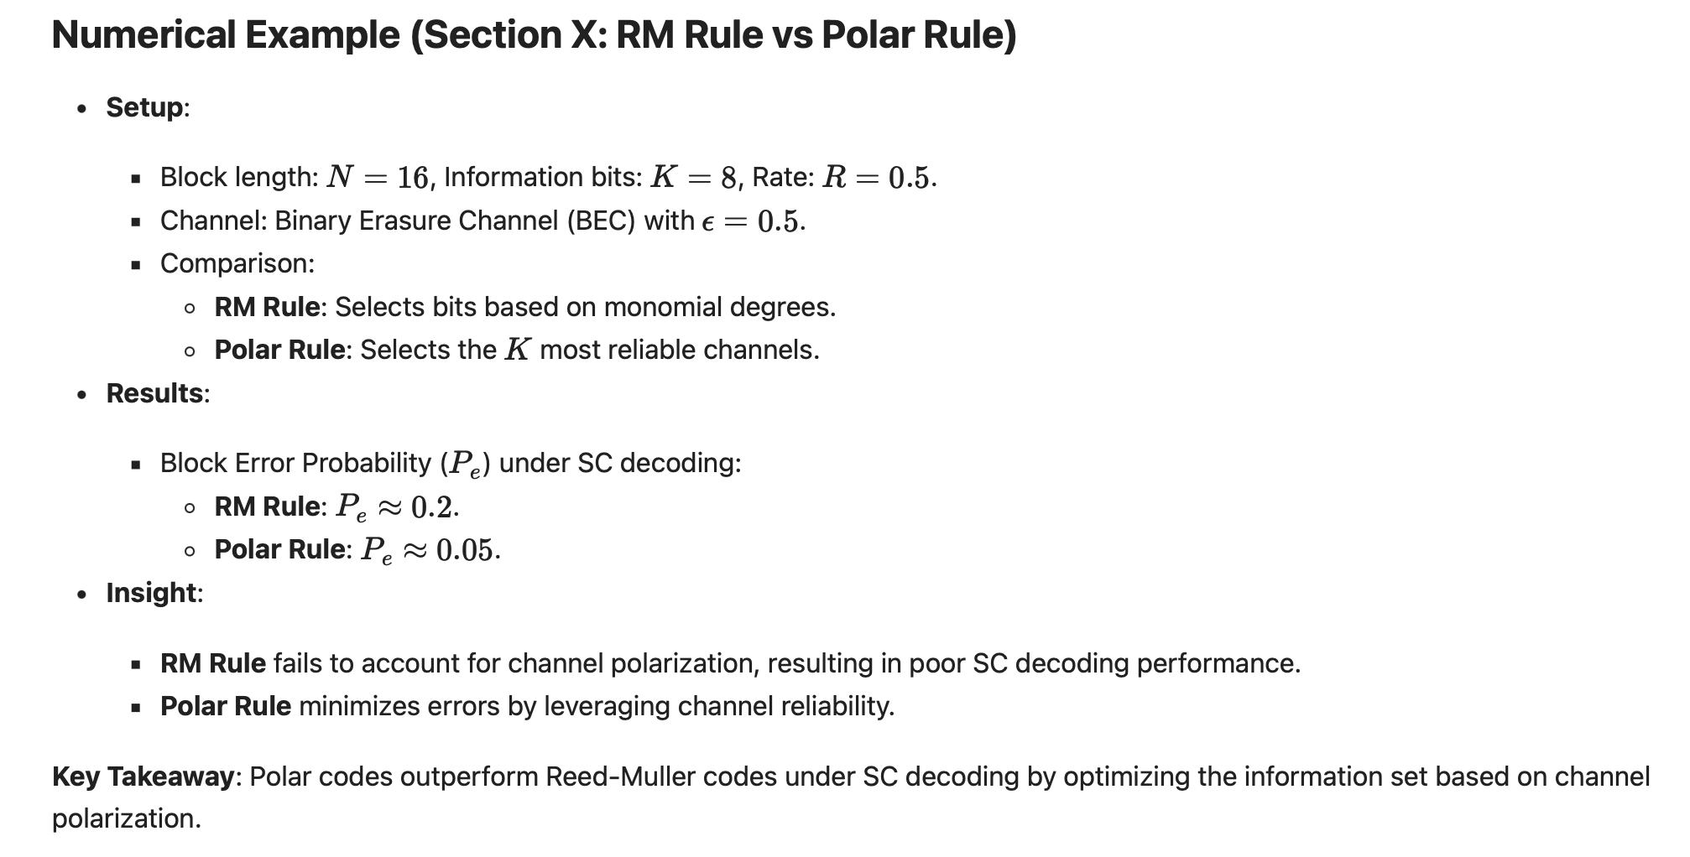
Numerical Examples (Section X)

Slide 18

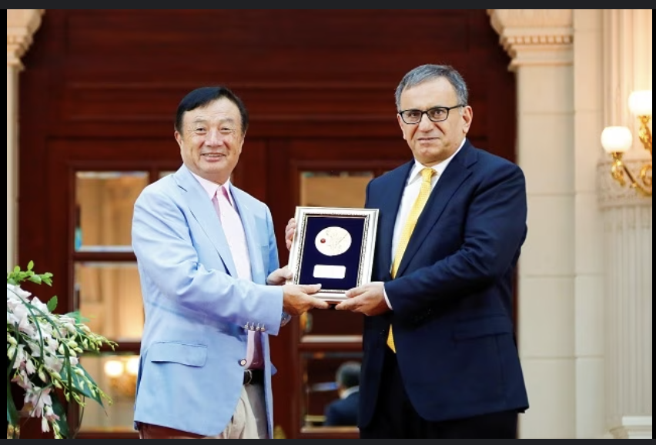

Conclusion (Section XI)
Polar Codes in 5G Standard
Where:
  Used in Control Channels for:
    Downlink Control Information (DCI) (scheduling, signaling).
    Uplink Control Information (UCI) (ACK/NACK, CSI).
Why:
  Short Block Lengths: Optimal performance for N=32N = 32 to N=512N = 512.
  Low Latency: Efficient decoding using CRC-Aided Successive Cancellation List (CA-SCL) Decoding.
  Capacity-Achieving: Approaches channel capacity for control information.
Comparison:
  Polar Codes: Control channels (short, reliable).
  LDPC Codes: Data channels (long, throughput-focused).
Key Takeaway:
Polar codes are chosen for 5G control channels due to their reliability, flexibility, and efficiency at short block lengths.
Erdal Arıkan
Advisor: Robert G. Gallager MIT: 1981
https://gitlab.eurecom.fr/oai/openairinterface5g
Tenure-track assistant professor at the
University of Illinois at Urbana-Champaign

